Slide 1

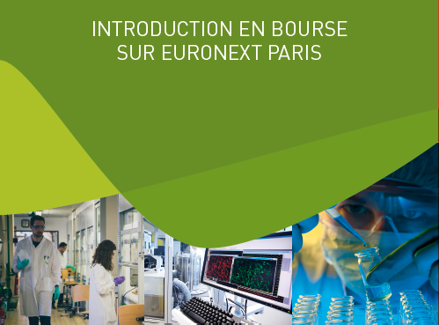


43rd Annual J.P. Morgan Healthcare Conference
January 13-16, 2025

Slide 2
Disclaimer
This presentation contains “forward-looking statements” within the meaning of the safe harbor provisions of the Private Securities Litigation Reform Act of 1995. All statements, other than statements of historical facts, included in this presentation are forward-looking statements. These statements include, but are not limited to, forecasts and estimates with respect to Inventiva’s pre- clinical programs and clinical trials, including design, duration, timing, recruitment costs, last patient first visit, screening, randomization, enrollment, and last patient last visit for those trials, including the ongoing NATiV3 Phase clinical trial with lanifibranor in MASH, and the results and timing thereof and regulatory matters with respect thereto, clinical trial data releases and publications, the information, insights and impacts that may be gathered from clinical trials, the potential therapeutic benefits of Inventiva’s product candidates, including lanifibranor alone and in combination with empagliflozin in patients with MASH and T2D, the potential of lanifibranor to address patient needs, market forecasts including with respect to products developed by other companies, estimates of addressable markets, and targeted development and commercial timelines, including with respect to relative market position, potential regulatory submissions, approvals and commercialization, Inventiva’s pipeline and preclinical and clinical development plans, the expected benefit of having received Breakthrough Therapy Designation from the FDA, including its impact on the development and review timeline of Inventiva’s product candidates, the opportunity for lanifibranor based on the current clinical program, future activities, expectations, plans, growth and prospects of Inventiva and its partners, the expected benefit of Inventiva’s partnerships, conclusions drawn from expectations in survey results and analyses of blinded interim results, the anticipated proceeds from Inventiva’s multi-tranche equity financing and Inventiva’s expected use of such proceeds. Certain of these statements, forecasts and estimates can be recognized by the use of words such as, without limitation, “believes”, “anticipates”, “expects”, “intends”, “plans”, “seeks”, “estimates”, “may”, “will”, “would”, “could”, “might”, “should”, “designed”, “hopefully”, “target”, “potential”, “opportunity”, “possible”, “aim”, and “continue” and similar expressions. Such statements are not historical facts but rather are statements of future expectations and other forward-looking statements that are based on management's beliefs. These statements reflect such views and assumptions prevailing as of the date of the statements and involve known and unknown risks and uncertainties that could cause future results, performance, or future events to differ materially from those expressed or implied in such statements. Actual events are difficult to predict and may depend upon factors that are beyond Inventiva's control. There can be no guarantees with respect to pipeline product candidates that the clinical trial results will be available on their anticipated timeline, that future clinical trials will be initiated as anticipated, that product candidates will receive the necessary regulatory approvals, or that any of the anticipated milestones by Inventiva or its partners will be reached on their expected timeline, or at all. Future results may turn out to be materially different from the anticipated future results, performance or achievements expressed or implied by such statements, forecasts and estimates due to a number of factors, including that Inventiva cannot provide assurance on the impacts of the SUSAR, including the ultimate impact on the results or timing of the NATiV3 trial or regulatory matters with respect thereto, that Inventiva is a clinical-stage company with no approved products and no historical product revenues, Inventiva has incurred significant losses since inception, Inventiva has a limited operating history and has never generated any revenue from product sales, Inventiva will require additional capital to finance its operations, in the absence of which, Inventiva may be required to significantly curtail, delay or discontinue one or more of its research or development programs or be unable to expand its operations or otherwise capitalize on its business opportunities and may be unable to continue as a going concern, Inventiva’s ability to obtain financing and to enter into potential transactions or further arrangements with its creditors and the impacts therefrom, Inventiva's future success is dependent on the successful clinical development, regulatory approval and subsequent commercialization of current and any future product candidates, preclinical studies or earlier clinical trials are not necessarily predictive of future results and the results of Inventiva's and its partners’ clinical trials may not support Inventiva's and its partners’ product candidate claims, Inventiva's expectations with respect to its clinical trials may prove to be wrong and regulatory authorities may require holds and/or amendments to Inventiva’s clinical trials, Inventiva’s expectations with respect to the clinical development plan for lanifibranor for the treatment of MASH may not be realized and may not support the approval of a New Drug Application, Inventiva and its partners may encounter substantial delays beyond expectations in their clinical trials or fail to demonstrate safety and efficacy to the satisfaction of applicable regulatory authorities, the ability of Inventiva and its partners to recruit and retain patients in clinical studies, enrollment and retention of patients in clinical trials is an expensive and time-consuming process and could be made more difficult or rendered impossible by multiple factors outside Inventiva's and its partners’ control, Inventiva's product candidates may cause adverse drug reactions or have other properties that could delay or prevent their regulatory approval, or limit their commercial potential, Inventiva faces substantial competition and Inventiva’s and its partners' business, and preclinical studies and clinical development programs and timelines, survey results may not be indicative of broader views and the views expressed in survey results may be inaccurate and/or may change over time, results of prior trials may not be indicative of future trial results, Inventiva’s financial condition and results of operations could be materially and adversely affected by geopolitical events, such as the war in Ukraine and related sanctions, impacts and potential impacts on the initiation, enrollment and completion of Inventiva’s and its partners’ clinical trials on anticipated timelines and the conflict in the Middle East and the related risk of a larger conflict, health epidemics, and macroeconomic conditions, including global inflation, rising interest rates, uncertain financial markets and disruptions in banking systems. Given these risks and uncertainties, no representations are made as to the accuracy or fairness of such forward-looking statements, forecasts, and estimates. Furthermore, forward-looking statements, forecasts and estimates only speak as of the date of this presentation. Readers are cautioned not to place undue reliance on any of these forward-looking statements. Please refer to the Universal Registration Document for the year ended December 31, 2023 filed with the Autorité des Marchés Financiers on April 3, 2024, as amended on October 14, 2024, and the Annual Report on Form 20-F for the year ended December 31, 2023 filed with the Securities and Exchange Commission (the “SEC”) on April 3, 2024 and the Half-Year Report for the six months ended June 30, 2024 on Form 6-K filed with the SEC on October 15, 2024. Other risks and uncertainties of which Inventiva is not currently aware may also affect its forward-looking statements and may cause actual results and the timing of events to differ materially from those anticipated. All information in this presentation is as of the date of the release. Except as required by law, Inventiva has no intention and is under no obligation to update or review the forward-looking statements referred to above. Consequently, Inventiva accepts no liability for any consequences arising from the use of any of the above statements. This presentation shall not constitute an offer to sell or the solicitation of an offer to buy any securities, nor shall there be any sale of securities in any state or jurisdiction in which such offer, solicitation or sale would be unlawful prior to registration or qualification under the securities laws of any such state or jurisdiction. This presentation includes information and statements of third parties. Inventiva does not make any representation with respect to the accuracy or otherwise with respect to such third party information.

Slide 3
Lanifibranor: strong therapeutic profile for the MASH market
Potential to be the second oral liver-targeted therapy to the market
Best in Class Oral Efficacy Data
Differentiated pan-PPAR Agonist
Phase IIb demonstrated 18% fibrosis placebo-adjusted improvement at 6 months
Differentiated profile that has been observed to improve cardiovascular, glycemic and metabolic markers and reduce insulin resistance
Balanced pan-PPAR agonist activity, once-daily dosing, IP protection through 2040
Two novel PPAR agents approved for use in chronic liver disease and included in hepatology guidelines suggesting interest in novel PPAR class agents
Differentiated Safety & Tolerability Profile
Significant Near-Term Commercial Opportunity
Differentiated safety profile in the PPAR class that surveyed KOLs and Gastroenterologists/Hepatologists are very comfortable with if confirmed in Phase III
Non-overlapping AE profile with incretin agonists, allowing for combination therapy
Phase III ~95% enrolled; projected 1H25 enrollment completion and 2H26 Phase III data readout
Lanifibranor could be the second liver-targeted and the next oral agent on the market in 2028
A multi-tranche equity financing of $400M+ secured in October 2024 led by New Enterprise Associates, BVF Partners and Samsara BioCapital capitalized Inventiva to execute on the clinical trial through NDA⁽¹⁾
(1) In October 2024, Inventiva announced a multi-tranche equity financing of up to €348 million, subject to conditions, and up to $30 million in milestone payments. If all tranches close, the proceeds are expected to fully fund the development of lanifibranor through its Phase III trial and potential NDA filing

Slide 4
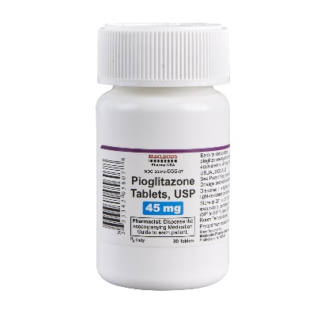
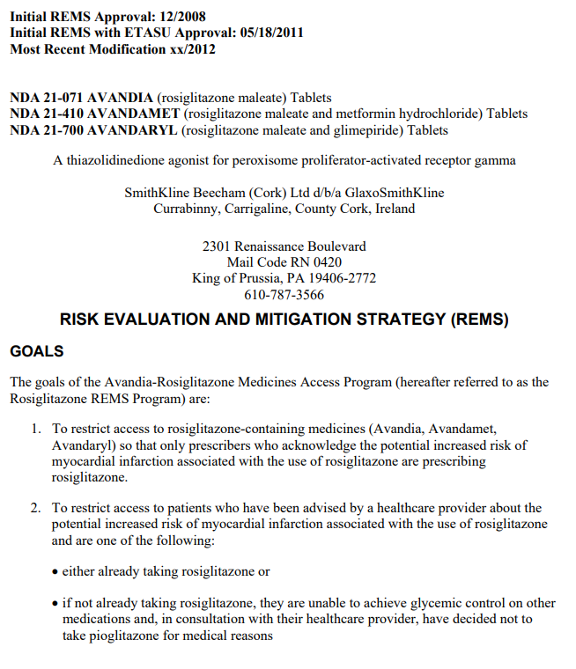
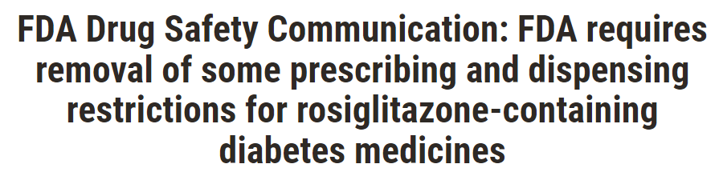

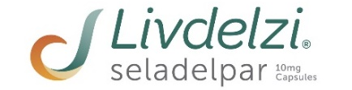
The PPAR story has evolved: two novel agents are now approved in PBC
Regulatory authorities have shifted to a more positive stance on the class
1999
2004
2008
2009
2008
2014
2019
2024
1999 FDA Approval of Pioglitazone
2008 Rosiglitazone REMS Program
2012 Rosiglitazone REMS Removed
2024 Approval of two PPARs for PBC
Rosiglitazone did not demonstrate an increased risk of heart attack compared to the standard T2D medicines
Side effects including suspicion of bladder cancer, and cardiac toxicity erodes the perception of PPARs, especially TZD’s
Rosiglitazone REMS program leaves a cloud over the whole PPAR field
Beyond Rosiglitazone – since 2012, meta-analyses demonstrated no association between pioglitazone and bladder cancer.
Pioglitazone consistently shows outcomes benefit in multiple patient populations
PPARs approved for use in PBC, and if lanifibranor is approved for the treatment of MASH and gets to market, the hepatology community is likely to broadly accept PPARs for chronic liver disease.
Source: GILD/CBAY Press Releases; IPN Press Releases; FDA Communications; KOL Interviews; Inventiva Analysis.
PBC: Primary Biliary Cholangitis; T2D: Type 2 Diabetes; REMS: Risk Evaluation and Mitigation Strategy; TZD: Thiazolidinediones

Slide 5


Clinicians and industry have recognized the value of PPAR agonists
Prescriptions and M&A support the potential of this class of drugs
Physicians continue to prescribe pioglitazone
with over 6M scrips written in 2023 in the U.S.
Gilead acquires Cymabay for
$4.3B in February 2024
Pioglitazone U.S. Annual TRx
 | 2022 | 2023 | 1H24
ACTOPLUS MET | 369 | 259 | 113
ACTOPLUS MET XR | 1 | 1 | –
ACTOS | 1,941 | 1,340 | 519
AVANDIA | 7 | 1 | 1
DUETACT | 35 | 16 | 2
PIOGLIT/GLIMEPIRID | 11,361 | 10,660 | 4,819
PIOGLIT/METFORMIN | 139,794 | 119,237 | 54,056
PIOGLITAZONE HCL | 6,025,851 | 5,882,329 | 2,861,187
TOTAL | 6,179,359 | 6,013,843 | 2,920,697
Pioglitazone is one of the recommended diabetes pharmacotherapy for patients with MASLD F0 to compensated cirrhosis⁽¹⁾
“It is my opinion that PPAR gamma activation remains most effective in repletion of adiponectin levels and adiponectin is the missing link that connects the health of visceral adipose depot to systemic inflammation.”
– Kris Kowdley, Director at Liver Institute Northwest, Washington.
Cymabay was developing seladelpar, a PPARδ- agonist in PBC, an orphan chronic liver indication
At time of Cymabay acquisition, results of the Phase III had been published but seladelpar was not yet approved by FDA nor EMA
Source: IQVIA Script Data; KOL Interviews; Inventiva Analysis; (1) 2025 ADA Standard of care

Slide 6
Lanifibranor: a pan-PPAR agonist with differentiated profile
A new chemical entity: not a fibrate, not a TZD
Moderate and balanced pan-PPAR agonist activity
150
PPARα
Small molecule that activates all three PPAR isoforms in humans
Balanced activity across the three human PPAR isoforms
Differentiated chemical structure: not a fibrate or a TZD
Once daily oral administration
FDA confirmation that the non-clinical toxicology package is complete and acceptable for NDA filing
In 2020, FDA granted lanifibranor breakthrough therapy and fast track designation for the treatment of MASH
IP protection through 2040
125
hPPARα
100
hPPARδ
%Activation
hPPARγ
75
PPARβ/δ
PPARγ
50
25
0
-10
-8
-6
-4
lanifibranor (M)
Pan-PPAR activity likely required for efficacy across MASH disease drivers
METABOLISM
STEATOSIS
INFLAMMATION AND BALLOONING
FIBROSIS
VASCULAR
PPARα
PPARδ
PPARγ
PPARγ
PPARα
PPARδ
PPARγ
PPARδ
PPARγ
Portal pressure
LSEC capillarization
Intrahepatic vascular resistance
PPARα
PPARγ
NFkB-dependent gene activation
Inflammasome
Ballooning
Stellate cell proliferation and activation
Collagen and fibronectin production
Insulin sensitivity
HDLc
Triglycerides
FA uptake
FA catabolism
Lipogenesis
TZD: Thiazolidinediones

Slide 7
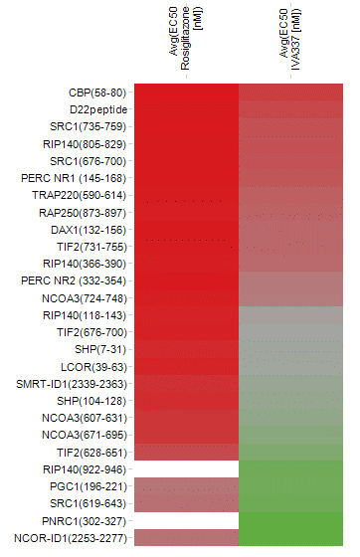




Balanced PPAR activity with differential binding/target engagement
Lanifibranor did not lead to the adverse events and toxicity previously seen in single/dual PPAR agonists
Moderate pan-PPAR agonist activity…
… that engages PPARγ differently
Compound | PPARα EC50 (nM) | PPARδ EC50 (nM) | PPARγ EC50 (nM)
Lanifibranor* | 1630 | 850 | 230
Fenofibrate | 2400 | - | -
Pioglitazone | - | - | 263
Rosiglitazone | - | - | 13
Elafibranor** | 10 | 100 | -
Seladelpar^ | - | 2 | -
Rosiglitazone
Lanifibranor
Induces different coactivator recruitment^^
Adverse events and toxicity previously seen in other single and dual PPAR agonists have not been observed with lanifibranor in preclinical studies
Organ | Isoforms activated | Reported PPAR side effects | Lanifibranor effects
HEART | PPARγ | Fluid retention Cardiac hypertrophy | Adverse events and toxicity of single / dual PPAR agonists not observed in primate and rodent studies
SKELETAL MUSCLE | PPARα | Myofiber degeneration
KIDNEY | PPARα | > 50% increases in creatinine, degenerative changes in renal tubules
URINARY BLADDER | PPARγ | Proliferative changes in bladder epithelium
Source: * Company data ** Hanf R et al, Diabetes & Vascular Dis Res 2014 ^ Cymabay company presentation ^^ J Med Chem. 2018 Feb 15. doi: 10.1021/acs.jmedchem.7b01285

Slide 8

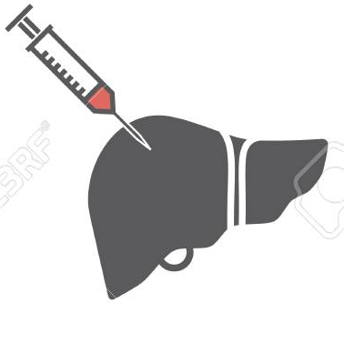
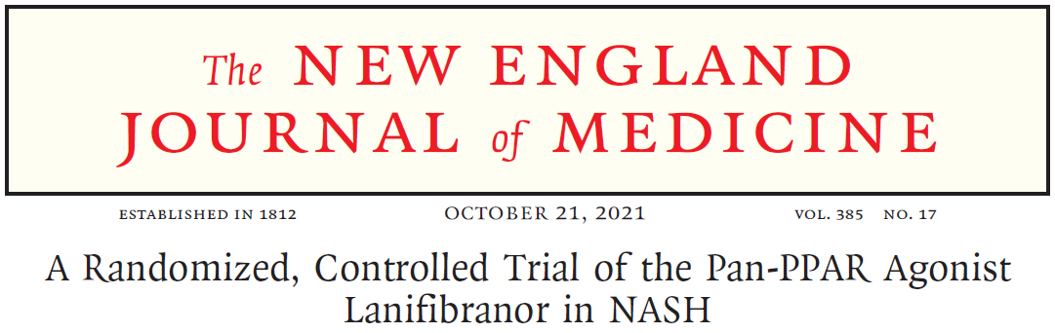
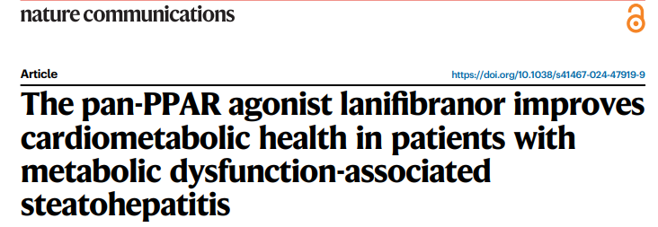
The Phase IIb NATIVE trial published in NEJM
Evaluated 800 & 1200mg, oral, once-daily, 247 patients
24-week treatment + 4-week follow-up
Double blind, randomized, placebo-controlled
ITT: 247 Patients Randomized Patients
Screening
Liver biopsy
End of treatment
Liver biopsy
Placebo
lanifibranor, 800 mg once daily
lanifibranor, 1200 mg once daily
Randomization 1/1/1
Stratification on
type 2 diabetes
  Main inclusion criteria: patients with biopsy-proven MASH confirmed by central reader having Steatosis-Activity-Fibrosis (SAF) scores of 1-3 for steatosis, 3-4 for activity, and <4 for fibrosis
  Results published in the New England Journal of Medicine ⁽¹⁾ and additional analysis in Nature Communications ⁽²⁾
A Randomized, Controlled Trial of the Pan-PPAR Agonist Lanifibranor in NASH, N Engl J Med 2021;385:1547-1558 (2) The pan-PPAR agonist lanifibranor improves cardiometabolic health in patients with metabolic dysfunction-associated steatohepatitis | Nature Communications

Slide 9
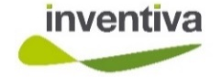






Resolution of MASH and fibrosis improvement ≥ least 1 stage Compares favourably to other oral and injectable compounds
ORAL
INJECTABLE
PPARs
THR-β
FGF-21
GLP1-RA and GLP1-RA dual agonists
Lanifibranor
Resmetirom**
Efruxifermin
Pegozafermin
Semaglutide
Survodutide
Tirzepatide
Phase II 6 months
N=247
Phase III 12 months
N=955
Phase IIb 6 months
N=128
Phase IIb 24 months
N=126
Phase II 6 months
N=222
Phase III 18 months
N=800
Phase II 12 months
N=223 (F2/F3)
Phase II 12 months
N=190
ITT
ITT
ITT
PP
PP
Effect size
24%*
Effect size
11%
Effect size
28%
Effect size
28%
Effect size
20%
Effect size
16.6%
Endpoint not disclosed
Pbo
800mg
1200mg
Pbo
80mg
100mg
Pbo
28mg
50mg
Pbo
28mg
50mg
Pbo
15mg
QW⁽¹⁾
30mg
QW
***
44mg
Q2W
***
Pbo
2.4mg
0.017*
<0.001*
<0.0001*
<0.0001*
0.009*
0.002*
<0.01*
<0.01*
No head-to-head clinical trials have been conducted; results obtained from different trials, with different designs, endpoints and patient populations. Results may not be comparable.
*Effect size was 26% in the 1200 mg arm in patients with T2D **Resmetirom has been approved under accelerated approval by the FDA.
Source: lanifibranor native results; Efruxifermin Safety and efficacy of once-weekly efruxifermin versus placebo in non-alcoholic steatohepatitis (HARMONY): a multicentre, randomised, double-blind, placebo-controlled, Phase IIb trial. Lancet Gastroenterology October 2023 ; Semaglutide Phase III ESSENCE trial of semaglutide 2.4mg in participants with non-cirrhotic non-alcolohic steatohepatitis; Newsome et al.; Resmetirom MAESTRO MASH top-line results webcast Dec. 19 2022, pg 10 and EASL 2023 presentation pg. 8; Efruxifermin EASL 2023 presentation pg. 8, corporate presentation of March 2024 pg 22; Survodutide A Phase II randomized trial for Survodutide in MASH and fibrosis, The NEJM DOI: 10.1056/NEJMoa2401755; Tirzepatide Tirzepatide for Metabolic Dysfunction-Associated Steatohepatitis with Liver Fibrosis, The NEJM DOI: 10.1056/NEJMoa2401943

Slide 10
Fibrosis improvement ≥ 1 stage with no worsening of MASH
Compares favourably to other oral and injectable compounds
ORAL
INJECTABLE
PPARs
THR-β
FGF-21
GLP1-RA and GLP1-RA dual agonists
Lanifibranor
Resmetirom**
Efruxifermin
Pegozafermin
Semaglutide
Survodutide
Tirzepatide
Phase II 6 months
N=247
Phase III 12 months
N=955
Phase IIb 6 months
N=128
Phase IIb 24 months
N=126
Phase II 6 months
N=222
Phase III 18 months
N=800
Phase II 12 months
N=293
Phase II 12 months
N=190
ITT
ITT
ITT
PP
PP
ITT
ITT
Effect size
18%
Effect size
12%
Effect size
14%
Effect size
20%
Effect size
20%
Effect size
15%
Effect size
21%
Effect size
21%
Pbo
800mg
1200mg
Pbo
80mg
100mg
Pbo
28mg
50mg
Pbo
28mg
50mg
Pbo
15mg
QW
30mg
QW
44mg
Q2W
Pbo
2.4mg
Pbo
2.4
QW
4.8
QW
6mg
QW
Pbo
5mg
10mg
15mg
0.53
0.011*
0.0002*
<0.0001*
0.033*
0.123
<0.01*
0.1*
0.008*
0.008*
No head-to-head clinical trials have been conducted; results obtained from different trials, with different designs, endpoints and patient populations. Results may not be comparable.
* Resmetirom has been approved under accelerated approval by the FDA.
Source: lanifibranor native results;; resmetirom MAESTRO NASH top-line results webcast Dec. 19 2022, pg 10; resmetirom : Harrison et al, Lancet 2019 ; S0140-6736(19) 32517-6 Efruxifermin Safety and efficacy of once-weekly efruxifermin versus placebo in non-alcoholic steatohepatitis (HARMONY): a multicentre, randomised, double-blind, placebo-controlled, Phase IIb trial. Lancet Gastroenterology October 2023; corporate presentation of March 2024 pg15; Semaglutide Phase III ESSENCE trial of semaglutide 2.4mg in participants with non-cirrhotic non-alcolohic steatohepatitis; Newsome et al.; Pegozafermin, 89Bio Phase IIb ENLIVEN Topline Results presentation; Survodutide A Phase II randomized trial for Survodutide in MASH and fibrosis, The NEJM DOI: 10.1056/NEJMoa2401755 ; Tirzepatide Tirzepatide for Metabolic Dysfunction-Associated Steatohepatitis with Liver Fibrosis, The NEJM DOI: 10.1056/NEJMoa2401943

Slide 11
MASH resolution with no worsening of fibrosis
Compares favourably to other oral and injectable compounds
ORAL
INJECTABLE
PPARs
THR-β
FGF-21
GLP1-RA and GLP1-RA dual agonists
Lanifibranor
Resmetirom**
Efruxifermin
Pegozafermin
Semaglutide
Survodutide
Tirzepatide
Phase II 6 months
N=247
Phase III 12 months
N=955
Phase IIb 6 months
N=128
Phase IIb 24 months
N=126
Phase II 6 months
N=222
Phase III 18 months
N=800
Phase II 12 months
N=293
Phase II 12 months
N=190
ITT
ITT
ITT
PP
PP
ITT
ITT
Effect size
26%
Effect size
20%
Effect size
46%
Effect size
18%
Effect size
24%
Effect size
40%
Effect size
35%
Effect size
52%
Pbo
800mg
1200mg
Pbo
80mg
100mg
Pbo
28mg
50mg
Pbo
28mg
50mg
Pbo
15mg
QW
30mg
QW
44mg
Q2W
Pbo
2.4mg
Pbo
2.4
QW
4.8
QW
6mg
QW
Pbo
5mg
10mg
15mg
<0.043*
<0.001*
<0.0001*
<0.0001*
0.005*
<0.001*
0.005*
<0.0001*
0.0009*
0.0005*
No head-to-head clinical trials have been conducted; results obtained from different trials, with different designs, endpoints and patient populations. Results may not be comparable.
* Resmetirom has been approved under accelerated approval by the FDA.
Source: lanifibranor native results;; resmetirom MAESTRO NASH top-line results webcast Dec. 19 2022, pg 10; resmetirom : Harrison et al, Lancet 2019 ; S0140-6736(19) 32517-6 Efruxifermin Safety and efficacy of once-weekly efruxifermin versus placebo in non-alcoholic steatohepatitis (HARMONY): a multicentre, randomised, double-blind, placebo-controlled, Phase IIb trial. Lancet Gastroenterology October 2023; corporate presentation of March 2024 pg15; Semaglutide Phase III ESSENCE trial of semaglutide 2.4mg in participants with non-cirrhotic non-alcolohic steatohepatitis; Newsome et al.; Pegozafermin, 89Bio Phase IIb ENLIVEN Topline Results presentation; Survodutide A Phase II randomized trial for Survodutide in MASH and fibrosis, The NEJM DOI: 10.1056/NEJMoa2401755 ; Tirzepatide Tirzepatide for Metabolic Dysfunction-Associated Steatohepatitis with Liver Fibrosis, The NEJM DOI: 10.1056/NEJMoa2401943

Slide 12
Statistically significant decrease in liver enzymes
Liver biomarkers show rapid and sustained improvement
Other secondary endpoints in ITT (N = 247)
SECONDARY ENDPOINTS
Absolute change from baseline in ALT
Absolute change from baseline in AST
**
**
*
**
*
**
**
**
**
*
*
**
0 W4 W14 W24
0 W4 W14 W24
* p<0.01 **p<0.001
Absolute change from baseline in GGT
A statistically significant decrease of ALT, AST and GGT in both lanifibranor dose groups observed after 4 weeks
**
**
**
**
**
**
0 W4 W14 W24

Slide 13
Statistically significant change in lipid profile
Improvements in HDL-cholesterol & triglycerides without a change in LDL-cholesterol
* p<0.01 **p<0.001
Other secondary endpoints in ITT (N = 247)
SECONDARY ENDPOINTS
Absolute change from baseline in HDL-C
Absolute change from baseline in triglycerides
**
**
**
*
**
**
**
**
**
0 W4 W14 W24
0 W4 W14 W24
Statistically significant change in HDL-cholesterol
A Statistically significant change in triglycerides
No change in LDL-cholesterol

Slide 14
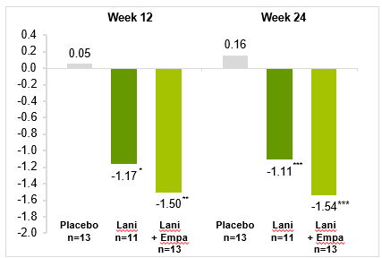

Clear benefit in MASH patients with T2D, across multiple studies
Significant reductions in HbA1c and fasting glucose
Reduction in HbA1c in patients with MASH and T2D
LS mean absolute change in hepatic insulin resistance index
**p<0.001
**
**
0 W4 W14 W24
Placebo
n=14
Lanifibranor
800mg
n=14
*p<0.05, **p<0.01, ***p<0.001, versus placebo (Mixed Model Repeated Measure [MMRM])
Note: two patients were not considered in the FAS because not having post-treatment values available:
1 patient under placebo who prematurely stopped before Week 4
1 patient under lanifibranor who received ‘Metformin’ as a rescue medication (intercurrent event) before Week 4 (Results were similar including this patient in a sensitivity analysis).
pª=0.02
Data from the clinical study conducted by Dr. Kenneth Cusi from the University of Florida, evaluating lanifibranor (800mg/day) in patients with NAFLD and type 2 diabetes mellitus (T2D) for 24 weeks

Slide 15
Weight gain is observed in ~33% of patients
Weight gain comes with improvements in metabolic, cardiometabolic, or liver markers
Mean absolute change at week 24 from baseline
Weight changes at end of treatment (week 24) in patients treated with lanifibranor versus placebo
Lanifibranor
Placebo
Lanifibranor
N=144
Placebo
N=73
Fasting HOMA-IR*
Lanifibranor
Placebo
Triglycerides*
Stable weight (≤2.5%)
Moderate weight
gain
(2.5%-5%)
Weight
gain
(>5%)
Stable weight (≤2.5%)
Moderate weight
gain
(2.5%-5%)
Weight
gain
(>5%)
ALT*
Body weight gain is likely attributed to an increase in adipose tissue and not water retention
Despite weight gain, significant improvements were observed in the VAT/SAT ratio
Similar results seen with:, CAP, APO-C3, APO-B, hs-CRP
Source: MP. Cooreman, Lanifibranor improves markers of cardio-metabolic health in MASH patients independent of weight change – EASL 2022

Slide 16
Lanifibranor has a differentiated weight gain profile relative to pioglitazone
Weight gain plateaus with lanifibranor after 24-36 weeks
Lanifibranor
Pioglitazone
D Weight
1.9
2.3
2.4
2.1
1.0
Pioglitazone
0.0
0.4
Vitamin E
Baseline
Week 4
Week 12
Week 24
Week 36
Week 48
Week 72
Placebo
End of treatment
Main/Exploratory F4
Main Cohort
Main
Cohort. N =
748
717
679
558
410
297
123
In the interim blinded data of the main cohort from NATiV3, lanifibranor shows a distinct plateau after week 24-36, consistent with prior data
~50% of patients on lanifibranor are maintaining stable weight, and the weight gain observed is different than that of overeating/excess calories
In PIVENS study, a 96-week randomized trial of pioglitazone vs vitamin E in patients with nondiabetic adults with MASH, mean weight increased 4.7kg after 96 weeks
Continuous weight gain over the full 96 weeks
While not conclusive, data suggests that lanifibranor weight gain stops after 24-36 weeks
“If you can get PPAR activation without the liabilities it could be a best-in-class drug” – Kris Kowdley
Source: Tan MH et al. Diabetes Care 28:544 –550, 2005; KOL Interviews; Inventiva Analysis.

Slide 17
SGLT2 inhibitor empaglifozin mitigates lanifibranor weight gain
Meta-analysis data suggest that GLP-1s have a similar effect when combined with PPARs
Lanifibranor + empagliflozin
Pioglitazone + GLP1 or SGLT2i
Baseline 63-137 kg
Week 4
n=13/12/13
Week 12
n=13/12/11
Week 24
n=9/12/10
Exenatide
Baseline
n=14/12/13
(n=pb/lani/lani+empa)
In the LEGEND trial, albeit with a small n, results suggested that empagliflozin, an SGLT2i, completely mitigated the lanifibranor weight gain profile over 24 weeks
Recently published meta-analyses suggested that pioglitazone with GLP1 or SGLT2i is associated with increased weight loss and reduced risk of heart failure compared with monotherapy
Most of the TZD-weight increases are driven by increased energy storage while SGLT2i/GLP1s induce caloric restriction, possibly explaining the MOA synergies
Source: Anson. 2024. Diabetes, Obesity, and Metabolism; KOL Interviews; Inventiva Analysis.

Slide 18
SGLT2 inhibitor empaglifozin mitigates lanifibranor weight gain
Meta-analysis data suggest that GLP-1s have a similar effect when combined with PPARs
Lanifibranor + empagliflozin
Pioglitazone + GLP1 or SGLT2i
Baseline 63-137 kg
Week 4
n=13/12/13
Week 12
n=13/12/11
Week 24
n=9/12/10
Exenatide
Baseline
n=14/12/13
(n=pb/lani/lani+empa)
In the LEGEND trial, albeit with a small n, results suggested that empagliflozin, an SGLT2i, completely mitigated the lanifibranor weight gain profile over 24 weeks
Recently published meta-analyses suggested that pioglitazone with GLP1 or SGLT2i is associated with increased weight loss and reduced risk of heart failure compared with monotherapy
Most of the TZD-weight increases are driven by increased energy storage while SGLT2i/GLP1s induce caloric restriction, possibly explaining the MOA synergies
Source: Anson. 2024. Diabetes, Obesity, and Metabolism; KOL Interviews; Inventiva Analysis.

Slide 19





Lanifibranor is well-positioned in the MASH market
Multiple competitive advantages vs. other therapies
 | pan-PPAR | THR-β | FGF-21 | GLP-1
Route of administration | Oral | Oral | Injectable | Injectable
Fibrosis improvement | Direct activity seen at 6 months | Indirect seen after 12 months | Direct activity seen at 6 months | Indirect seen with sema. after 18 month. Reported by BI & Lilly after 12 months
MASH resolution
Insulin resistance
Tolerability | Limited dropout Limited GI side effects | Limited dropout GI side effects on initiation | High dropout due to GI side-effects & injections | High dropout due to GI side-effects & injections
Lanifibranor
Data suggests fibrosis improvement, MASH resolution and cardiometabolic benefits
Balanced pan-PPAR agonists have a favorable insulin sensitivity profile, manageable AEs and oral route of administration
Promising candidate for patients with advanced fibrosis and/or for combination therapy, particularly in patients with comorbid T2D
Notes:
Results justified by MOA that respobnds very well to the features of the disease; our Moa is differentiating versus competition

Slide 20
MASH with advanced fibrosis represents a high unmet medical need
Patients with MASH and type 2 diabetes are at higher risk
MASH U.S. Prevalence and Progression Estimates by Fibrosis Stage
(US, 2030)
Millions
3.1
9.0
22% of patients with F3 fibrosis progress to cirrhosis within 2yrs
T2D is an independent predictor of fibrosis progression
T2D is an independent risk factor for mortality in patients with NAFLD
1.41X
6.1
Increased risk of liver-related mortality
10X
4.5
17X
3.5
Comorbidity with T2D
Despite Rezdiffra approval, treatment needs still exist for patients with advanced fibrosis…
RezdiffraTM ‘s published rates of fibrosis improvement are indirect and at best modest with 12% effect size
RezdiffraTM has no impact on glycemic parameters
RezdiffraTM does not appear to synergize with incretins, where use is growing in obesity
Pipeline agents targeting FGF21 are injectable and have an unfavorable GI AE profile
MASH patients need more than one oral option available to them
Source: Estes. 2018. Hepatology; Sanyal. EASL. 2024; Lomanoco Diabetes Care 2021;44(2):399–406; Angulo P, et al. Gastroenterology. 2015;149:389-397. 2. Loomba R, Adams L. Hepatology. 2019;70(6):1885-1888; Noureddin et al. AASLD 2024; KOL Interviews; Inventiva Analysis.
NAFLD: Nonalcoholic fatty liver disease; MASH: Metabolic dysfunction-associated steatohepatitis

Slide 21
KOL discussions suggest that lanifibranor has significant potential
Could play a key role in the highest unmet need segments in MASH
Priority patient segment based on KOL feedback at time of lanifibranor launch
F2 (~25%)
F3 (~27%)
F4cc (~10%)
Pan-PPAR agonists have strong antifibrotic and insulin sensitivity profile, and the AEs are manageable
“Lean” MASH (~10%)
THR-β
FGF21
Obesity / CV Risk (50 – 55%)
GLP-1
Despite efficacy in fibrosis reversal, MASH resolution, and cardiometabolic benefits, FGF21s use may be limited by GI side effects, bone density reduction and injectable RoA
Pan-PPAR
T2D and Obesity (20 – 25%)
THR-β agonists have modest efficacy and may be used in early-stage patients, though the oral ROA is attractive
KOLs view GLP-1s as modestly effective anti-fibrotic, but key backbone therapy to treating the whole patient with proven benefit in multiple comorbidities
T2D
(15 – 20%)
With the observed antifibrotic, insulin-sensitizing and cardio-metabolic benefits, lanifibranor is well positioned in the market for MASH patients with advanced fibrosis and T2D
Source: KOL Interviews; Inventiva Analysis.

Slide 22


NATiV3 recruitment is nearly complete
Trial design mirrors the successful ph2b study
Main Cohort
Accelerated Approval
72 weeks treatment
N~ 950
Non-cirrhotic MASH &
F2-F3 fibrosis
Lanifibranor: 1200 mg once daily
Lanifibranor: 800 mg once daily
Active Treatment Extension Trial
48 weeks
Placebo: Once daily
Exploratory Cohort
EoT
72 weeks treatment
Lanifibranor: 1200 mg once daily
N~ 350
Lanifibranor: 800 mg once daily
Screen failed patients from the main cohort
Non-cirrhotic MASH &
F1-F4 fibrosis
Lanifibranor: 1200 mg once daily
All patients who complete the main or the exploratory cohort are eligible for the Phase III active treatment extension trial
Lanifibranor: 800 mg once daily
Placebo: Once daily
Primary endpoint: Composite endpoint of patients having both MASH resolution and one stage fibrosis improvement
Key secondary endpoints: MASH resolution and no worsening of fibrosis, Fibrosis improvement and no worsening of MASH
GLP1: Patients under a stable dose of GLP1-RA for at least 3 months prior to screening can be included
Statistical powering: 90% considered for sample size calculations
Stratification by fibrosis stage and diabetic status
Over 1200 patients randomized: main cohort ~95% enrolled
In a blinded analysis conducted comparing phase IIb and NATiV3, baseline values and magnitude of changes in relevant biomarkers are consistent

Slide 23

NATiV3 data is expected in 2026
Lanifibranor could be the second oral liver-directed agent for the treatment of MASH if approved
Targeted timeline for anticipated catalysts
Lanifibranor
2025
2026
2027
2028
H1 2025
Last Patient First Visit
H2 2026
Last Patient Last Visit and Topline Results
2027
New Drug Approval filing with FDA
Financing
Targeted Timeline to Potential Launch
A $400M+ Financing in October 2024 capitalized Inventiva to execute on the clinical trial through to NDA¹
Lanifibranor could be the second oral, liver-targeted agent on the market in 2028 if NDA is filed and approved.
Best-in-class fibrosis, cardiovascular, and metabolic benefits.
(1) In October 2024, Inventiva announced a multi-tranche equity financing of up to €348 million, subject to conditions, and up to $30 million in milestone payments. If all tranches close, the proceeds are expected to fully fund the development of lanifibranor through its Phase III trial and potential NDA filing.

Slide 24

Contacts
Inventiva
Pascaline Clerc
Executive VP
Strategy and Corporate Affairs
Brunswick
Tristan Roquet Montégon
Aude Lepreux
Julia Cailleteau
Media relations
Westwicke, an ICR Company Patricia L. Bank Investor relations
pascaline.clerc@inventivapharma.com
+1 202 499 8937
inventiva@brunswickgroup.com
+ 33 1 53 96 83 83
patti.bank@westwicke.com +1 415 513 1284

